Slide 1


Project Title
Advanced Password Cracker
Unlocking the World of Cybersecurity Simulations

Slide 2


Advanced Password Cracker
A Tool for Ethical Hacking & Education

Slide 3

The Need for Ethical Password Recovery Tools
In the realm of cybersecurity education, practical tools are essential. Our Advanced Password Cracker addresses this need by providing a safe, controlled environment for:
Understanding password vulnerabilities.
Learning password cracking techniques ethically.
Simulating real-world security scenarios.

Slide 4





Core Technologies & Capabilities
Python & Tkinter
Hashing Algorithms
Robust backend scripting and intuitive GUI development.
Support for MD5 and NTLM hash cracking for diverse scenarios.
Rainbow Tables & Wordlists
Simulated Attacks
Efficient cracking methods using precomputed hashes and dictionary attacks.
Modules for Wi-Fi and website brute-force simulations for practical learning.

Slide 5


Key Features: What Makes It Stand Out
Beginner-Friendly GUI
Multi-Feature Integration
Intuitive interface for new users to navigate cracking tools effortlessly.
A unified platform for various password recovery techniques.
Dark Mode Interface
Educational Simulation
Enhanced user comfort during extended use.
Safe and ethical environment for hands-on learning.

Slide 6

Who Benefits from This Tool?
Ethical Hacking Students: Gain practical experience with password vulnerabilities and cracking methods in a safe environment.
Cybersecurity Trainers: Utilize a versatile tool for demonstrating complex concepts and conducting interactive workshops.
Penetration Testers: Access a simplified, yet powerful, utility for internal testing and validating security controls.

Slide 7
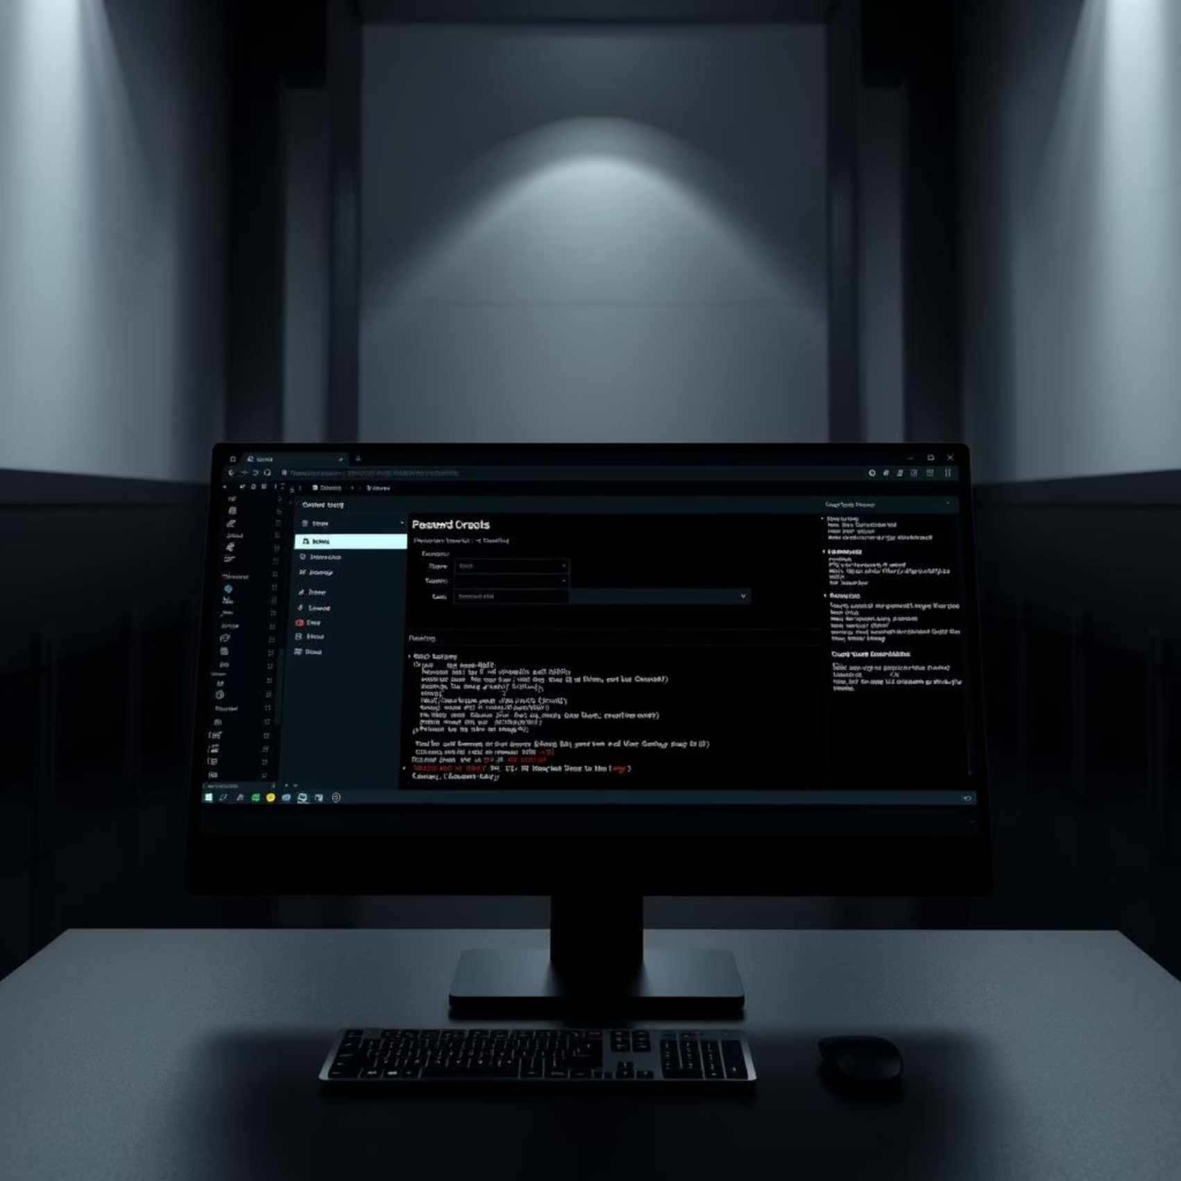
The Result: A Functional Desktop Application
Our project culminates in a fully functional desktop application designed for ease of use and educational impact.
Key Outcomes:
User-friendly GUI built with Tkinter.
Accessible tool for password recovery simulations.
Provides a secure sandbox for learning.

Slide 8
Conclusion & Educational Value
The Advanced Password Cracker stands as a valuable educational asset, offering a practical pathway to understanding cybersecurity fundamentals.
"This tool empowers students and professionals to explore password security in a controlled, ethical manner, bridging the gap between theoretical knowledge and practical application."
Its modular design also ensures expandability and adaptability to future cybersecurity challenges.

Slide 9




Future Scope & Enhancements
Real-time Password Strength Analysis
Integrate a module to provide instant feedback on password robustness.
Expanded Hash Algorithm Support
Incorporate additional algorithms like SHA-256 and bcrypt for broader testing capabilities.
Multi-Language Support
Develop localization options to make the tool accessible to a global audience.

